Slide 1
Social Media Marketing
Book: Social media Marketing, The Next Generation of Business Engagement
by Dave Evans
Instructor: Syed Mahdi Abbas Shah
Contact: 0314 4913418
Email: mahdi.abbas1214@gmail.com

Slide 2
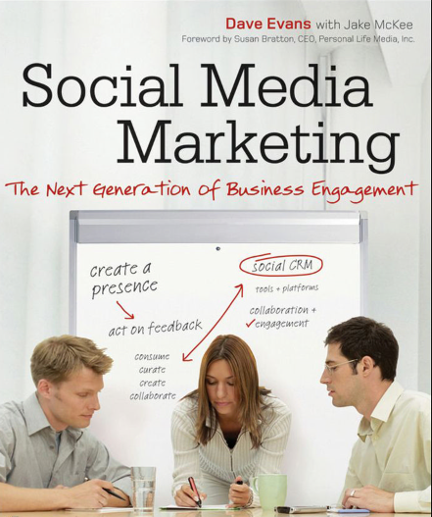

Slide 3
Praise for Social Media Marketing: The Next Generation of Business Engagement
“ Social media has become a primary tool for higher levels of fan engagement, directly driving lead generation through interaction and content sharing that is especially relevant to media companies. Social Media Marketing: The Next Generation of Business Engagement deconstructs the tools and techniques, showing you how to apply social technology to your business.”
—Johni Fisher, CEO, Looppa, Buenos Aires

Slide 4
Cont..
“ Innovation is not a one-way street where you walk alone! Take your customers on the journey, and see the difference. Social technologies, clearly explained in Dave’s book, enable you and your customers to work as a team.” —Kaushal Sarda, Founder, Uhuroo, Bangalore

Slide 5
Social Media
websites and applications that enable users to create and share content or to participate in social networking.

Slide 6
Social Media Marketing
Social media marketing (SMM) is a form of internet marketing that uses social media apps as a marketing tool. These social media platforms enable brands to connect with their audience to, build a brand, increase sales and drive traffic to a website.

Slide 7
Mainly Course Division
We can Divide this course in Three major Parts
Social Business Fundamentals
Run a Social Business
Social Business Building Blocks

Slide 8
Social Business Fundamentals
Part I will get you up-to-speed quickly on the primary aspects of social technology and how it applies to business.

Slide 9
Run a Social Business
Part II takes you deeper into the application of social technology to your business or organization, showing you how business decisions are informed through collaborative software and surrounding processes.

Slide 10
Social Business Building Blocks
Part III takes social technology as it is applied to business down to its basic elements.
Engagement and Customer Advocacy, Social CRM, social objects, and the social graph are all covered (and defined) to give a you a solid understanding of the principles of social business and the use of social technology.

Slide 11
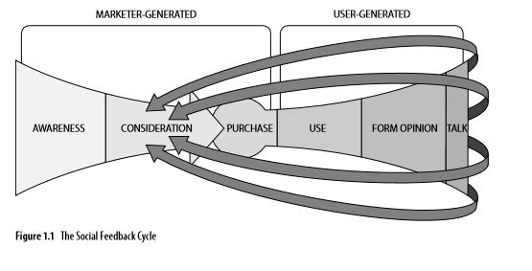
Social Media and Customer Engagement Social Feedback Cycle

Slide 12
Open Access to Information
it forms the basis of social business
social feedback loop really represents is the way in which Internet-based publishing
social technology has connected people around business or business-like activities
social connectivity applies between a business and its customers (B2C), between other businesses (B2B

Slide 13
Social Business: The Logical Extension
Social business follows right on the heels of the wave of interest and activity around social media and its direct application to marketing
Social business is the logical extension of THE SOCIAL FEEDBACK CYCLE
Social business takes social concepts—sharing, rating, reviewing, connecting, and collaborating
becomes more about change management than marketing. That’s a big thought.

Slide 14
Cont..
Ideas for product or service innovation
Early warning of problems or opportunities
Awareness ads (testimonials)
Market expansions (ideas for new product applications)
Customer service tips that flow from users to users
Public sentiment around legislative action, or lack of action
Competitive threats or exposed weaknesses

Slide 15
Social Business Is Holistic
Larger than the loop that connects sales with marketing
one of the areas considered as part of traditional Customer Relationship Management (CRM)
the Social Feedback Cycle literally wraps the entire business.

Slide 16
The Connected Customer
If Customers will well connected on social media then social business takes two added steps.
First, social business practices provide formal, visible, and transparent connections that link customers and the business.
Second, because employees are connected and able to collaborate—social business and Web 2.0 technology applies internally just as it does externally

Slide 17
The Social Web and Engagement
This next section provides a conceptual starting point in understanding how the critical activities of engagement and response are enabled through the adoption of social technology and supporting processes.
It’s a different viewpoint than that which applies to “engagement” in traditional media.
Engagement on the Social Web means customers or stakeholders become participants rather than viewers.

Slide 18
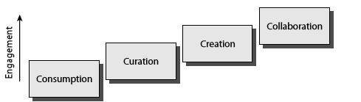
The Engagement Process
Engagement is central to the effective use of social technology and the creation of social business.

Slide 19
Consumption
The first of the foundational blocks in the process of building strong customer engagement is consumption.
Consumption, as used in the context of social media, means downloading, reading, watching, or listening to digital content.
Consumption is the basic starting point for nearly any online activity, and especially so for social activities.

Slide 20
Curation
Curation is the act of sorting and filtering, rating, reviewing, commenting on, tagging, or otherwise describing content.
Curation makes content more useful to others.
Curation also happens more broadly, at a general content level.
Curation is an important social action in that it helps shape, prune, and generally increase the signal-to-noise ratio within the community.

Slide 21
Creation
Beyond curation is what is more generally recognized as “content creation.”
content creation requires that community members actually offer up something that they have made themselves.
“You can upload your photos!” by itself is generally not enough. How do you encourage creation.
Step 1 is providing tools, support, help, templates, samples, and more.
The less work your members have to do the better.

Slide 22
Collaboration
Finally, at the top of the set of the core social-business building blocks is collaboration.
Collaboration is a key inflection point in the realization of a vibrant community and the port of entry for true social business.
Collaboration is necessarily strong social actions than all other engagement processes.
Collaboration occurs naturally between members of the community when given the chance.

Slide 23
The Engagement Process and Social Business
Taken together, the combined acts of consumption, curation, creation, and collaboration carry participants in the conversations around your business from readers to talkers to co-creators.
Two fundamentally important considerations that are directly applicable to your business or organization come out of this.
First, your audience is more inclined to engage in collaborative activities—sharing thoughts, ideas, concerns—that include you.
Second, because your customers or other stakeholders have moved from reading to creating and collaborating, they are significantly closer to the steps that follow collaboration as it leads to engagement: trial, purchase, and advocacy.

Slide 24
Cont…
consider the following for better understanding
You don’t get to the really good results until you go through the necessary venting of people you’ve previously ignored: Opening up a dialog gives you a natural way to enable venting and healing.
The way you deal with negative issues is an exhibition of your true character: become a master and reap the rewards.
It’s your job to understand what was really meant, given whatever it was that was actually said. “I hate you” isn’t always as simple as it sounds: This kind of seemingly intense negativity may arise because the customer involved likes you enough to actually feel this way when things go wrong.
Ultimately, your customers want to see you do well: They want your product or service to please them.

